Slide 1



Slide 2
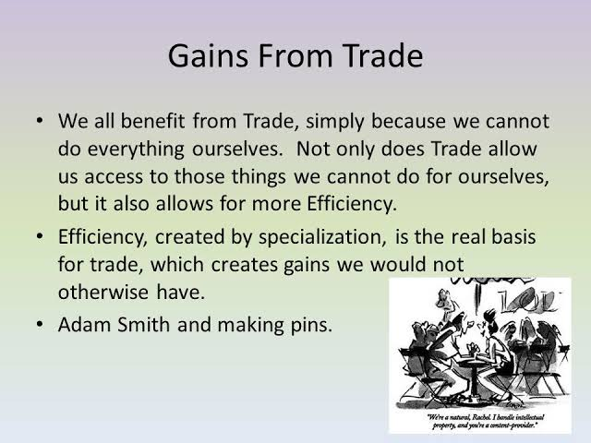

Slide 3

Terms of trade and gains from trade

Slide 4
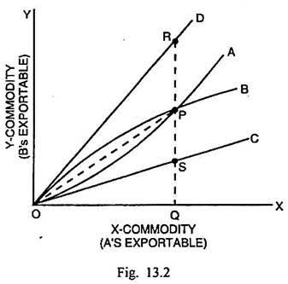
Offer curve

Slide 5

Increase in world production

Slide 6
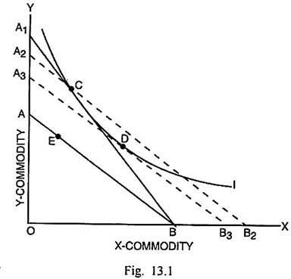
Increase in Consumption

Slide 7
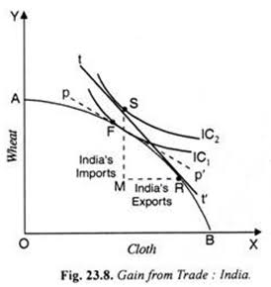
Higher Economic welfare

Slide 8
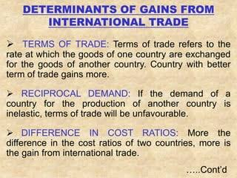

Slide 9
